Slide 1
Intro to Machine Learning
ECE 196 Week 3
Tutor: Jordan Levy
“All models are wrong, but some are useful” – George Box
Notes:
Before getting started, does anyone want to provide a definition of what they think machine learning is? (type in chat or unmute)
I want to start off with this quote or aphorism attributed to statistician George Box that says: “All models are wrong, but some are useful”… Keep this in mind when we go over our content today…
For people who have taken any machine learning classes, much of this will be an overview of what you have already learned, but this lecture will be necessary to get everyone up to speed and started on their reports…

Slide 2
Learning Objectives
What is Machine Learning? (ML)
What ML is and Common Tasks
Types of Learning
Classical Machine Learning Models
Classification
k-Nearest Neighbors
Regression
Linear Regression
Steps of a Machine Learning Project
Data Collection
Data Preprocessing
Exploratory Data Analysis (EDA)
Data Cleaning
Feature Extraction/Selection
Model Selection, Performance, and Hyperparameter Tuning
Training and Testing Data
Linear Model
Loss Function
Learning Algorithm
Logistic Regression and Support Vector Machines
Dimensionality Reduction: PCA
BeautifulSoup/Selenium
Decision Trees

Slide 3
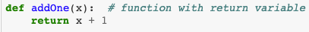
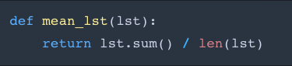
What is Machine Learning?
Traditional Computer Programming:
Tell the computer what to do.
Input: A number
Output: A number + 1
Computers can compute things much faster than humans, but they lack the intuition humans have.
How can we take advantage of this?
Input: A list
Output: Average of that list
Notes:
The first example may be pretty simple, but the second one may take extensive computation which would take a long time for humans, but be nearly instantaneous for a computer.

Slide 4
What is Machine Learning?
Machine Learning:
The computer learns what to do.
𝑓 ∶ X → Y
Common Tasks:
Prediction
Clustering
Representation Learning
Reinforcement Learning
Anomaly Detection
Source: https://www.bluedata.com/blog/2018/05/deploying-machine-learning-pipelines-for-ai-use-cases/
Notes:
Prediction -- Predicting either a discrete or continuous value, typically broken down into regression and classification
Clustering – Finding patterns in data
Representation Learning – Taking the data in the format it is given to you and representing in a different way
Reinforcement Learning– Given an objective function for a specific task, what steps can we take to optimize its performance at that task. Used in Artificial Intelligence.
Anomaly Detection-– Determining if new data is statistically different from our current

Slide 5

Example: Object Recognition
What is this?
Input: An Image
𝑓 ∶ X → Y
Output: A classification: ‘Traffic Light’
Notes:
What is this a picture of? (type in chat or unmute)
How do we know it is this? (input)
While this question can be better tackled using deep learning, there are classic ml ways to classify this…

Slide 6
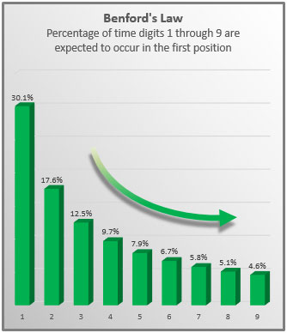
Key Theme: Finding Patterns in Data
In Machine Learning, it is important to have structure in your data such that we can find ‘meaningful’ patterns
Examples:
What is fraud vs what is not fraud?
Looking at a CT scan: Cancer vs not cancer
What do people search for?
What will a company’s stock price be?
How will a sports player perform?
Notes:
Meaningful in quotations because any pattern can be found and applied in data
Fraud vs not fraud: again an example where we aren’t able to process large data to detect these differences..
-- Interesting tangent: Benfords Law
I would encourage you all to think of these types of questions before starting your machine learning project, do something you are passionate about.

Slide 7
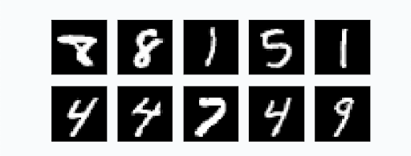
Types of Learning
Supervised Learning
Labelled Data
Clear input and output defined
Can make concrete predictions
Example: Classifying handwritten digits with labels
Unsupervised Learning
No label is given
ML algorithm finds patterns in data that we may not see
No concrete predictive task given
Typically applied in clustering
Example: Classifying handwritten digits with no labels.
Labels: 8 8 1 5 1
Labels: 4 4 7 4 9
What is the input and output in our example?
How is this represented in the computer?

Slide 8
Unsupervised Learning: Clustering
Clustering: algorithms detect groups from common features
Very common in data mining, pattern recognition, and image analysis
Source: Phuong Truong Machine Learning Lecture

Slide 9
Training and Testing Data
Training Data: Input and output given. Used to build model.
Testing Data: Input is given, output is held out. Used to test performance of model.
Validation Data: Used to prevent overfitting, functionally similar to testing data.
Source: https://datascience.stackexchange.com/questions/61467/clarification-on-train-test-and-val-and-how-to-use-implement-it

Slide 10
Learning Objectives
What is Machine Learning? (ML)
What ML is and Common Tasks
Types of Learning
Classical Machine Learning Models
Classification
k-Nearest Neighbors
Regression
Linear Regression
Steps of a Machine Learning Project
Data Collection
Data Preprocessing
Exploratory Data Analysis (EDA)
Data Cleaning
Feature Extraction/Selection
Model Selection, Performance, and Hyperparameter Tuning
Training and Testing Data
Linear Model
Loss Function
Learning Algorithm
Logistic Regression and Support Vector Machines
Dimensionality Reduction: PCA
BeautifulSoup/Selenium
Decision Trees

Slide 11
Regression and Classification
Regression: Predict a quantity y based on input x.
Example: Predict NBA points scored (y), based on Rebounds and Assists (X).
Classification: Predict a discrete value or class y based on input x.
Example: Classify a picture of a handwritten 7 as the number 7.
Source: Phuong Truong Machine Learning Lecture
Notes:
Regression: predicts continuous target value

Slide 12

Classification
How do we get from:
Input:
Output:
‘7’
to

Slide 13

k-Nearest Neighbors
Using Euclidean distance, find the k-Nearest points in training data to the point in your testing data
Output the class with the most ‘votes’
Source: Introduction to K-Nearest Neighbors
Notes:
kNN, known as a baseline model, does not require what we typically think of as machine learning.
Very intuitive though, we’ll be doing a demo on this later…

Slide 14
k-Nearest Neighbors (Cont.)
Using Euclidean distance, find the k-Nearest points in training data to the point in your testing data
Output the class with the most ‘votes’
k-Nearest Neighbors
784 Dimensions (28*28)
[[255 255 255],
… ,
[255 255 255]]
4: ‘7’
when k = 5
1: ‘8’
Notes:
kNN, known as a baseline model, does not require what we typically think of as machine learning.
Very intuitive though, we’ll be doing a demo on this later…

Slide 15
Learning Objectives
What is Machine Learning? (ML)
What ML is and Common Tasks
Types of Learning
Classical Machine Learning Models
Classification
k-Nearest Neighbors
Regression
Linear Regression
Steps of a Machine Learning Project
Data Collection
Data Preprocessing
Exploratory Data Analysis (EDA)
Data Cleaning
Feature Extraction/Selection
Model Selection, Performance, and Hyperparameter Tuning
Training and Testing Data
Linear Model
Loss Function
Learning Algorithm
Logistic Regression and Support Vector Machines
Dimensionality Reduction: PCA
BeautifulSoup/Selenium
Decision Trees

Slide 16

Dimensionality Reduction
Curse of Dimensionality: kNN struggles with too many dimensions, inability to generalize.
Principal Component Analysis: Reduce the dimensionality of our data while retaining as much variation as possible.
Identifies which directions captures the most
variance in our data.
Can drastically speed up computation time,
sometimes with even better accuracy.
Source: https://towardsdatascience.com/pca-is-not-feature-selection-3344fb764ae6

Slide 17
Learning Objectives
What is Machine Learning? (ML)
What ML is and Common Tasks
Types of Learning
Classical Machine Learning Models
Classification
k-Nearest Neighbors
Regression
Linear Regression
Steps of a Machine Learning Project
Data Collection
Data Preprocessing
Exploratory Data Analysis (EDA)
Data Cleaning
Feature Extraction/Selection
Model Selection, Performance, and Hyperparameter Tuning
Training and Testing Data
Linear Model
Loss Function
Learning Algorithm
Logistic Regression and Support Vector Machines
Dimensionality Reduction: PCA
BeautifulSoup/Selenium
Decision Trees

Slide 18
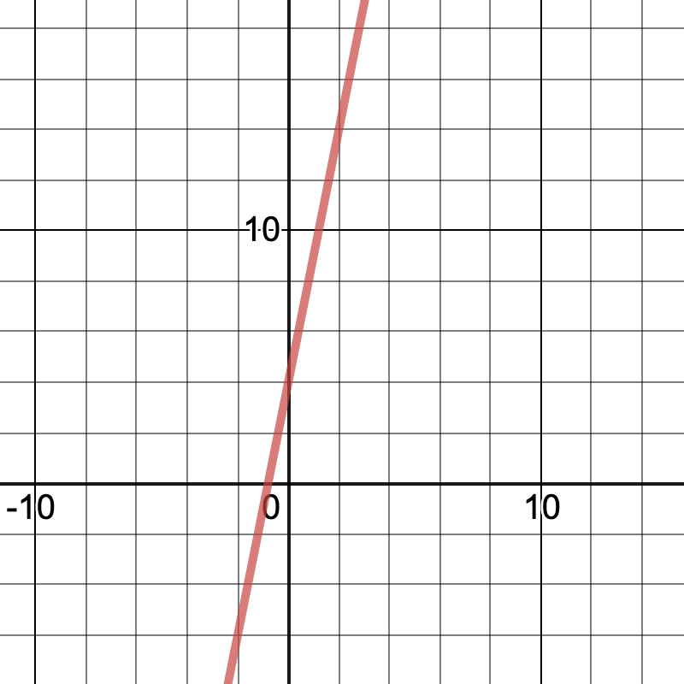
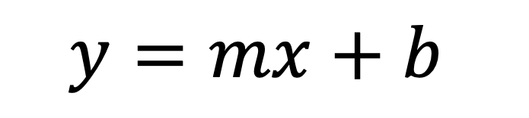
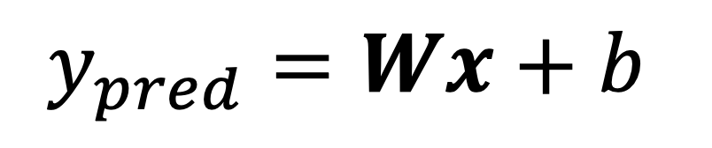
Linear Model
Conventional math:
Example: y = 5x + 4
Slope
Intercept
Output
Input
$$y=mx+b$$
Machine Learning Model:
Weights
Bias
Output
Input
$$y_{pred}=Wx+b$$
How do we evaluate our model?
Note: W is a vector of weights applied to a vector of inputs, whereas m and x are both scalar values
Notes:
F: X -> y

Slide 19
Learning Objectives
What is Machine Learning? (ML)
What ML is and Common Tasks
Types of Learning
Classical Machine Learning Models
Classification
k-Nearest Neighbors
Regression
Linear Regression
Steps of a Machine Learning Project
Data Collection
Data Preprocessing
Exploratory Data Analysis (EDA)
Data Cleaning
Feature Extraction/Selection
Model Selection, Performance, and Hyperparameter Tuning
Training and Testing Data
Linear Model
Loss Function
Learning Algorithm
Logistic Regression and Support Vector Machines
Dimensionality Reduction: PCA
BeautifulSoup/Selenium
Decision Trees

Slide 20
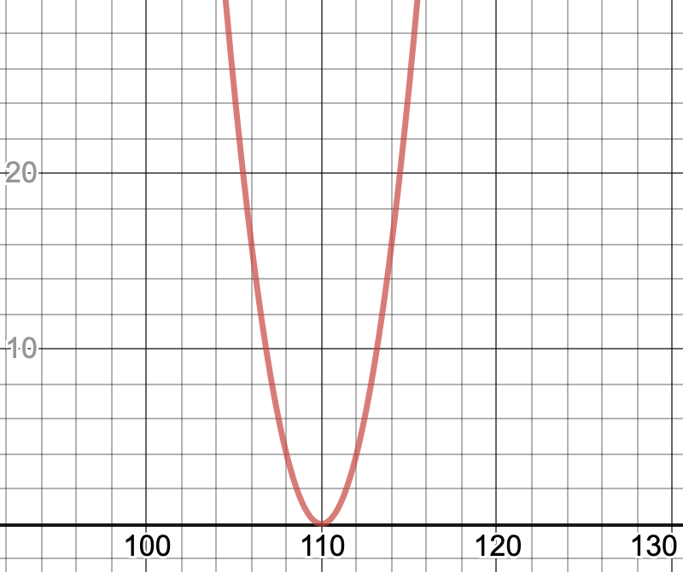
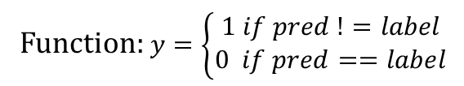
Loss Function
Loss Function: A function designed to evaluate the performance of your model.
Squared Error -- Take the square of the deviation from the target value.
Misclassification Loss -- loss is 0 if label is correct, 1 if label is incorrect
y-axis: Loss Value
Function: $y=\left\{\begin{matrix}1 if pred !=label \\ 0 if pred==label\end{matrix}\right.$
Target Value: x = 110
Function: y = (x - 110)²
2
1
0
y-axis: Squared Error
-2 -1 0 1 2
x-axis: Output of y=WX+b
x-axis: Predicted Value
Notes:
In two dimensions, we deem squared error to be a good measure of loss…

Slide 21
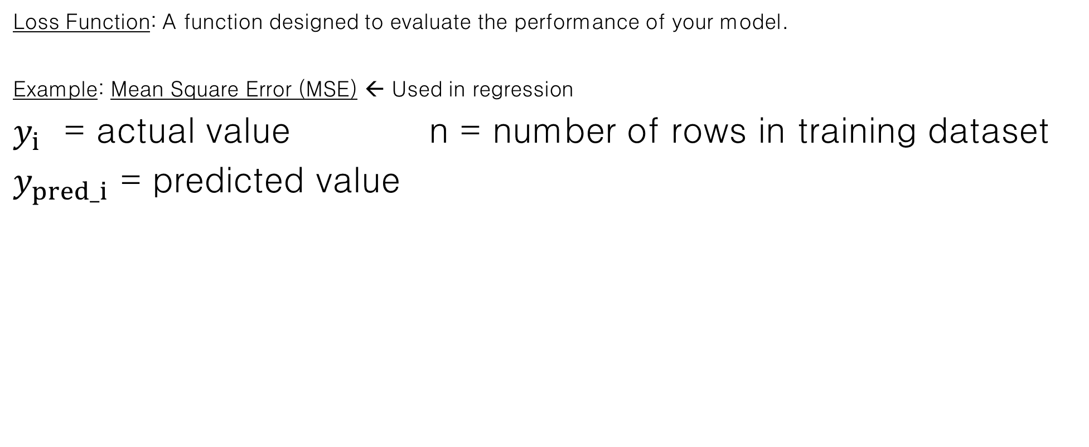
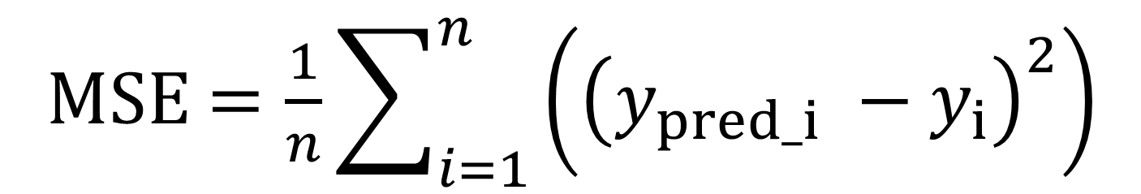

Loss Function (Cont.)
Loss Function: A function designed to evaluate the performance of your model.
Example: Mean Square Error (MSE) ← Used in regression
$y_{i}$ = actual value n = number of rows in training dataset
$y_{pred_i}$ = predicted value
$$.$$
MSE $=\frac{1}{n}\sum_{i=1}^{n}{\left({\left(y_{pred_i} −y_{i}\right)}^{2}\right)}$
We want to minimize this!!!
Notes:
Questions so far?

Slide 22
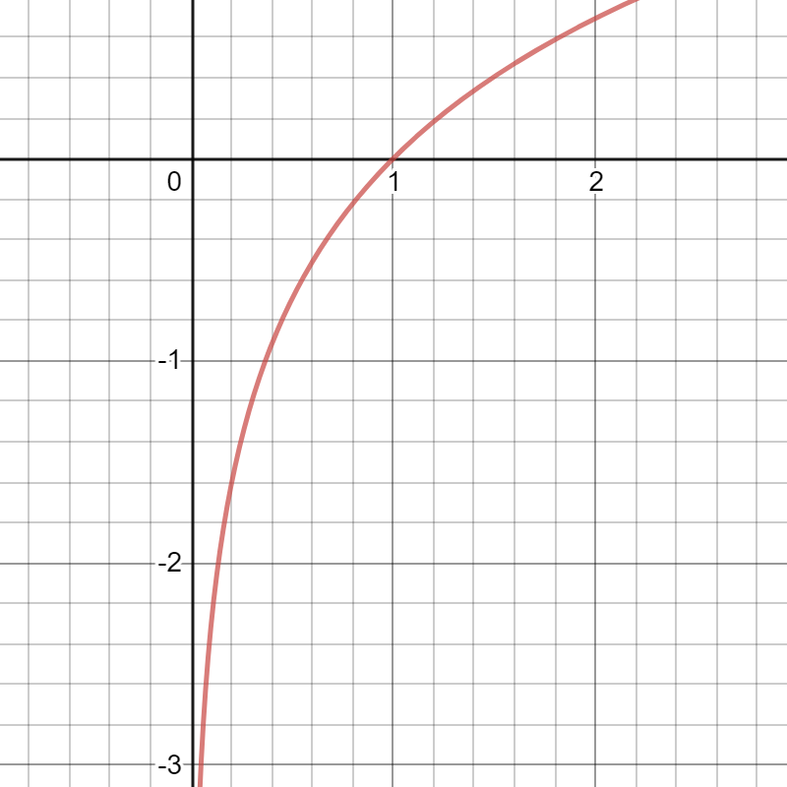

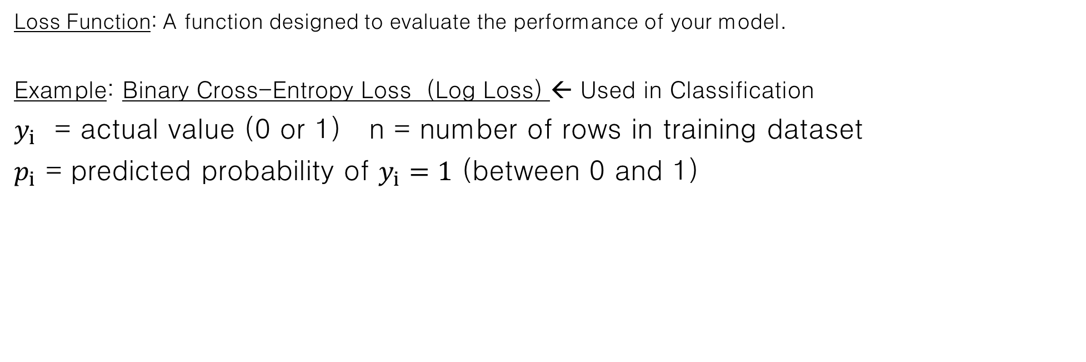
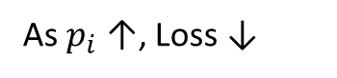
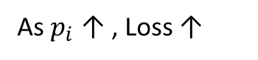


Loss Function (Cont.)
Loss Function: A function designed to evaluate the performance of your model.
Example: Binary Cross-Entropy Loss (Log Loss) ← Used in Classification
$y_{i}$ = actual value (0 or 1) n = number of rows in training dataset
$p_{i}$ = predicted probability of $y_{i}=1$ (between 0 and 1)
Plot of y = ln(x)
$$.$$
Log Loss $=−\frac{1}{n}\sum_{i=1}^{n}{\left(y_{i}∗log⁡\left(p_{i}\right)+\left(1−y_{i}\right)∗log⁡(1−p_{i})\right)}$
When $y_{i}$ = 1:
As $p_{i}$ ↑, Loss ↓
When $y_{i}$ = 0:
As $p_{i}$ ↑ , Loss ↑
We want to minimize this!!!
Notes:
Questions so far?

Slide 23
Learning Objectives
What is Machine Learning? (ML)
What ML is and Common Tasks
Types of Learning
Classical Machine Learning Models
Classification
k-Nearest Neighbors
Regression
Linear Regression
Steps of a Machine Learning Project
Data Collection
Data Preprocessing
Exploratory Data Analysis (EDA)
Data Cleaning
Feature Extraction/Selection
Model Selection, Performance, and Hyperparameter Tuning
Training and Testing Data
Linear Model
Loss Function
Learning Algorithm
Logistic Regression and Support Vector Machines
Dimensionality Reduction: PCA
BeautifulSoup/Selenium
Decision Trees

Slide 24

Learning Algorithm
How do we minimize our loss?
Gradient Descent: Update W and b in the direction that decreases MSE at the fastest rate.
https://www.youtube.com/watch?v=vWFjqgb-ylQ

Slide 25
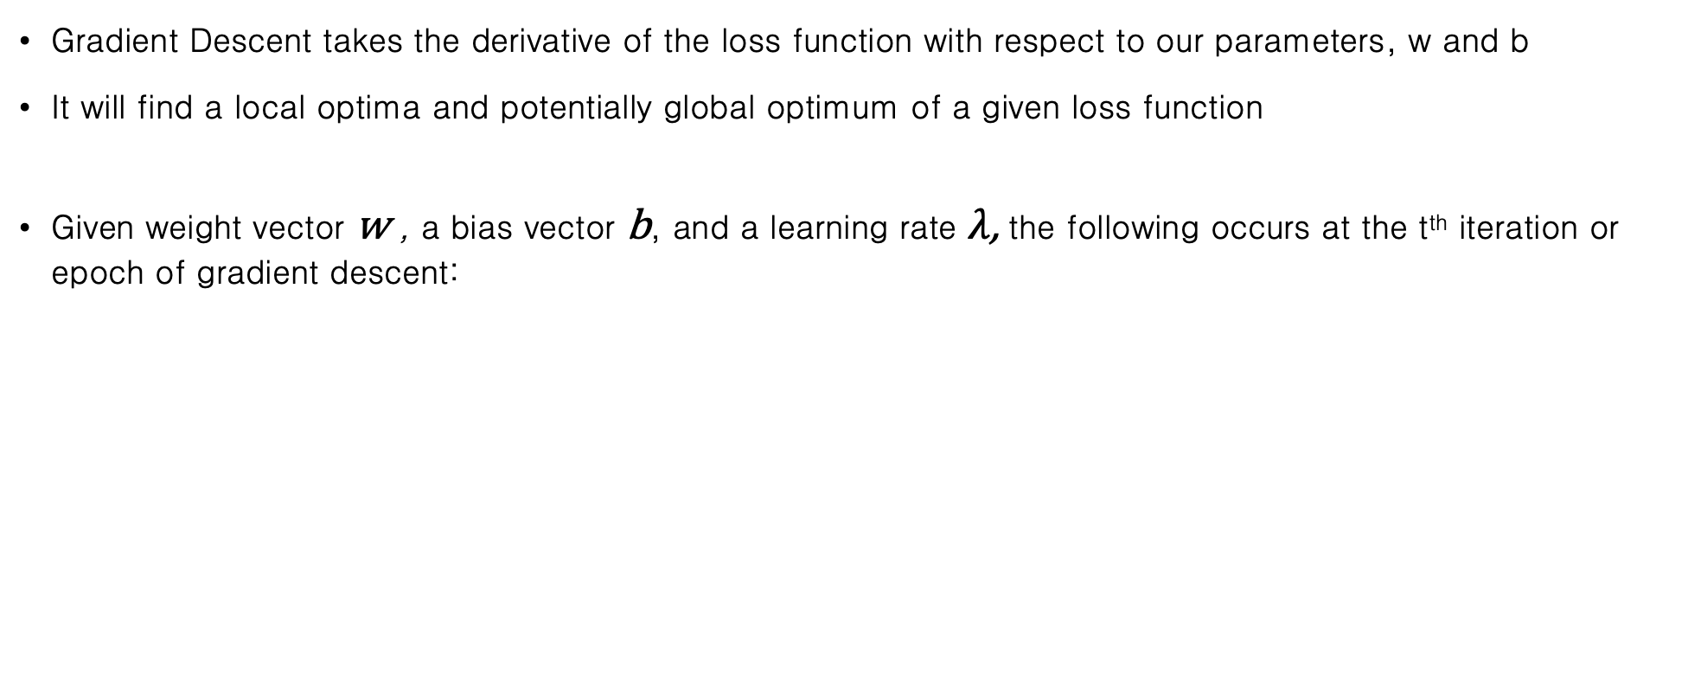
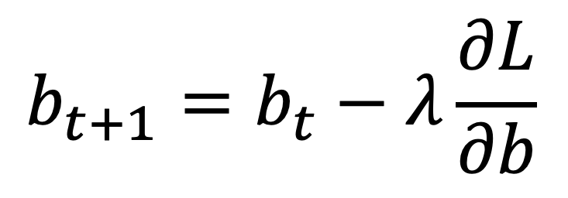
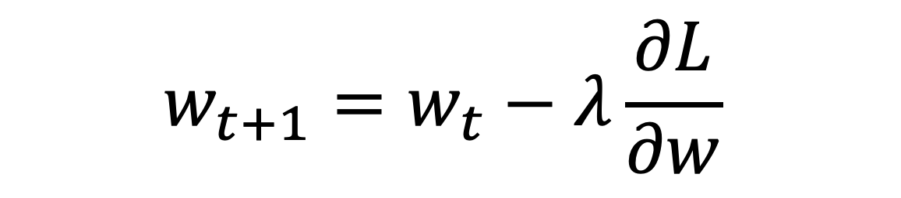
Learning Algorithm: Gradient Descent
Gradient Descent takes the derivative of the loss function with respect to our parameters, w and b
It will find a local optima and potentially global optimum of a given loss function
Given weight vector w , a bias vector b, and a learning rate $λ$, the following occurs at the t^{th} iteration or epoch of gradient descent:
W and b continue to be updated until the gradient falls below a certain level (0.01).
Parameter t can be set by user.
The algorithm that considers every value of w and b at once when computing the gradient is called Batch Gradient Descent.
$$w_{t+1}=w_{t}−λ\frac{∂L}{∂w}$$
$$b_{t+1}=b_{t}−λ\frac{∂L}{∂b}$$
Notes:
As a side note, there is a way to optimize linear regression outside of gradient descent …

Slide 26
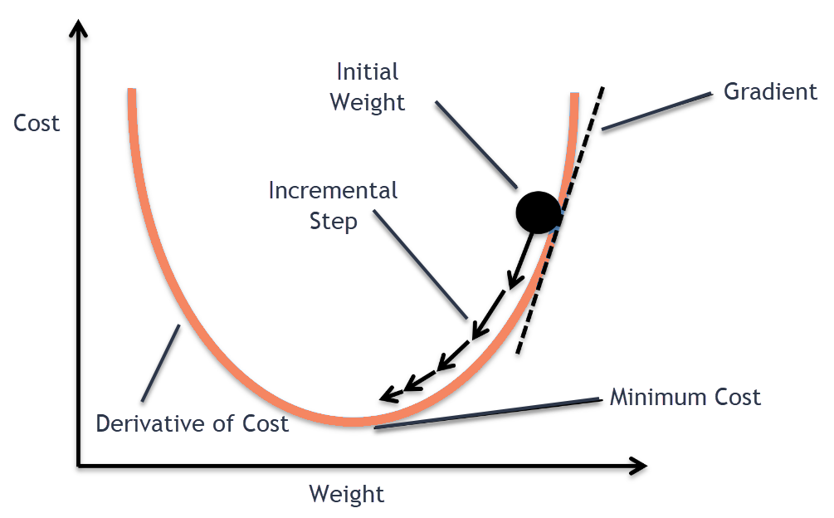
Stochastic Gradient Descent (SGD)
Stochastic Gradient Descent: A computationally more efficient method of performing Gradient Descent.
Only considers a subset of training data when computing the gradient.
Shuffles the data each iteration and takes the gradient until a local or global optimum is found.
Advantages over Batch Gradient Descent
Faster
Takes up less memory
More likely to find better local minima or global optimum
Source: https://medium.com/@divakar_239/stochastic-vs-batch-gradient-descent-8820568eada1
Notes:
As a side note, there is a way to optim

Slide 27
Learning Objectives
What is Machine Learning? (ML)
What ML is and Common Tasks
Types of Learning
Classical Machine Learning Models
Classification
k-Nearest Neighbors
Regression
Linear Regression
Steps of a Machine Learning Project
Data Collection
Data Preprocessing
Exploratory Data Analysis (EDA)
Data Cleaning
Feature Extraction/Selection
Model Selection, Performance, and Hyperparameter Tuning
Training and Testing Data
Linear Model
Loss Function
Learning Algorithm
Logistic Regression and Support Vector Machines
Dimensionality Reduction: PCA
BeautifulSoup/Selenium
Decision Trees

Slide 28
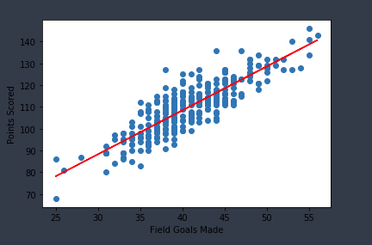
Linear Regression
Linear Regression: Predict a continuous target value y given
an input vector X.
Uses linear model y = Wx + b
Finds the Least Squares Regression line in n-dimensions
Linear Regression is the most widely used Machine Learning
algorithm.
Pros
Easy to interpret
Low model complexity, easy implementation
Cons
Struggles with high levels of non-linearity
Example: Linear Regression in 2 dimensions
W = 2.019
b = 27.7057

Slide 29
Learning Objectives
What is Machine Learning? (ML)
What ML is and Common Tasks
Types of Learning
Classical Machine Learning Models
Classification
k-Nearest Neighbors
Regression
Linear Regression
Steps of a Machine Learning Project
Data Collection
Data Preprocessing
Exploratory Data Analysis (EDA)
Data Cleaning
Feature Extraction/Selection
Model Selection, Performance, and Hyperparameter Tuning
Training and Testing Data
Linear Model
Loss Function
Learning Algorithm
Logistic Regression and Support Vector Machines
Dimensionality Reduction: PCA
BeautifulSoup/Selenium
Decision Trees

Slide 30
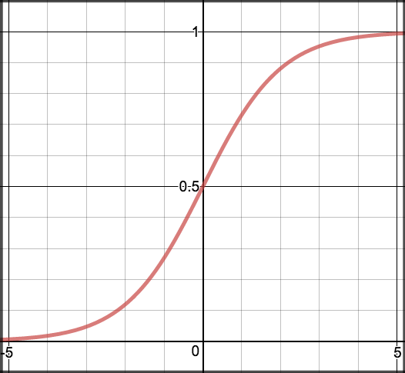
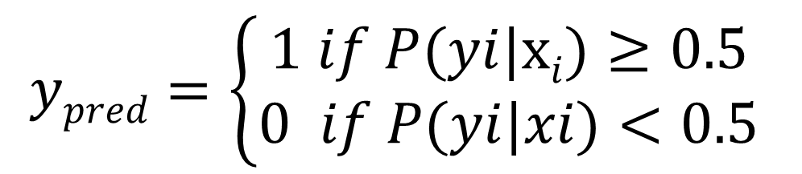
Logistic Regression
Logistic Regression: Predict the class with the highest probability, given an input vector x.
Despite its name, Logistic Regression is primarily used in classification problems.
Sigmoid function maps values to (0,1).
P(y_{i}|x_{i}) = σ(WX^{T} + B)
$$ypred=\left\{\begin{matrix}1 if P(yi|xi)≥0.5 \\ 0 if P(yi|xi)<0.5\end{matrix}\right.$$
Note: Logistic Regression uses log loss instead of MSE as it’s loss function. Log loss is also referred to as cross-entropy.
p = 1 / 1 +e^{-x}

Slide 31
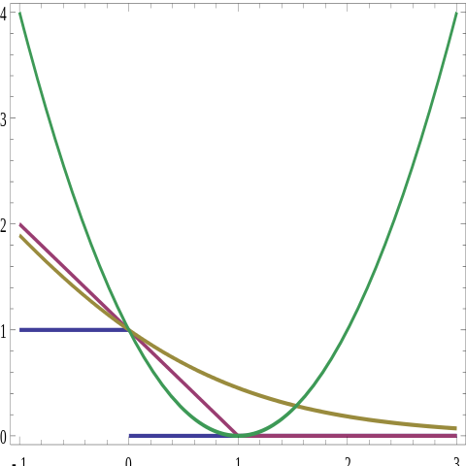
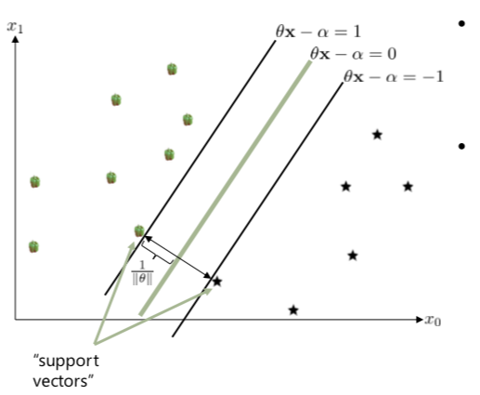
Support Vector Machine
Support Vector Machine: Comparable to Logistic Regression but aims to find a decision boundary with the maximum distance from the nearest points. If the data cannot be perfectly separated, they are penalized by their distance from the boundary.
Plot of various loss functions:
MSE in Green
Logistic Loss in Yellow
Hinge Loss in Red
Zero-One Loss in Purple
Source: https://towardsdatascience.com/optimization-loss-function-under-the-hood-part-iii-5dff33fa015d
Source: Julien McAuley, CSE 158

Slide 32
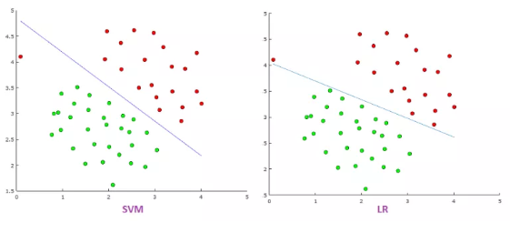
SVM vs Logistic Regression
SVM focuses on minimizing misclassified points, whereas Logistic Regression aims to find the smallest error among all points
Outliers have less influence on SVM than they do on Logistic Regression
Logistic Regression is always good to try first.
SVM tends to work better on semi-structured data and image classification than Logistic Regression
Try both out and see which one performs better
Notes:
Note in the graph the difference in decision boundary between SVM and Logistic Regression, SVM more robust, less affected by outliers…

Slide 33
Learning Objectives
What is Machine Learning? (ML)
What ML is and Common Tasks
Types of Learning
Classical Machine Learning Models
Classification
k-Nearest Neighbors
Regression
Linear Regression
Steps of a Machine Learning Project
Data Collection
Data Preprocessing
Exploratory Data Analysis (EDA)
Data Cleaning
Feature Extraction/Selection
Model Selection, Performance, and Hyperparameter Tuning
Training and Testing Data
Linear Model
Loss Function
Learning Algorithm
Logistic Regression and Support Vector Machines
Dimensionality Reduction: PCA
BeautifulSoup/Selenium
Decision Trees

Slide 34
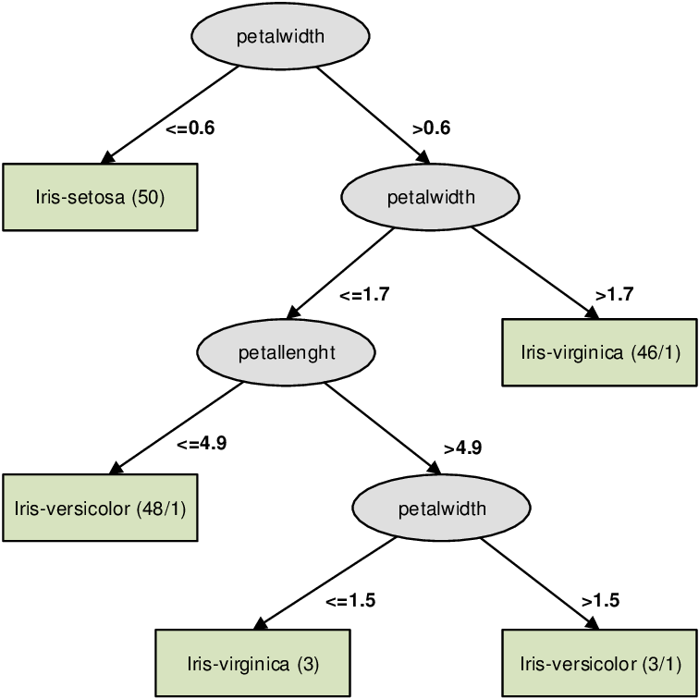
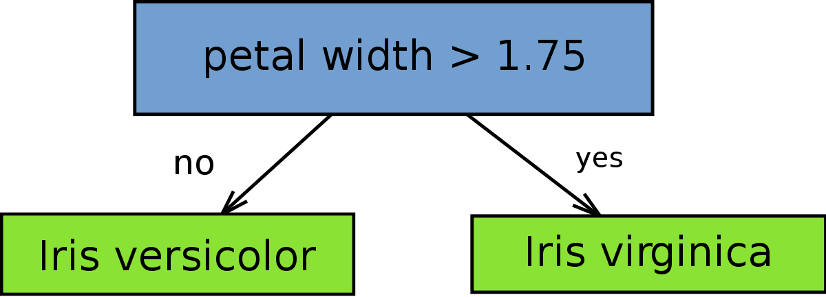
Decision Trees
Idea: Use a series of weak classifiers to build a strong classifier
Example: Iris Dataset
Decision Stump :
This decision stump achieves 94% accuracy for these two classes.
Source: Decision Stump on Wikipedia
Notes:
Click on Iris Dataset link after introducing the idea

Slide 35
Decision Trees (Cont.)
Uncertainty Scores
Misclassification Rate: min{p, 1-p}
Gini index: 2p(1 – p)
Entropy: p*log(1/p) + (1-p)*log(1/(1-p))
Source: Plot the decision surface of a decision tree on the iris dataset
Notes:
Boosting is a way or a method of combining these weak classifiers into a strong classifier…
Not going to get too in depth into the math as I’m not too familiar myself, but I believe it turns the process of choosing these classifiers into a gradient descent problem, where there is

Slide 36
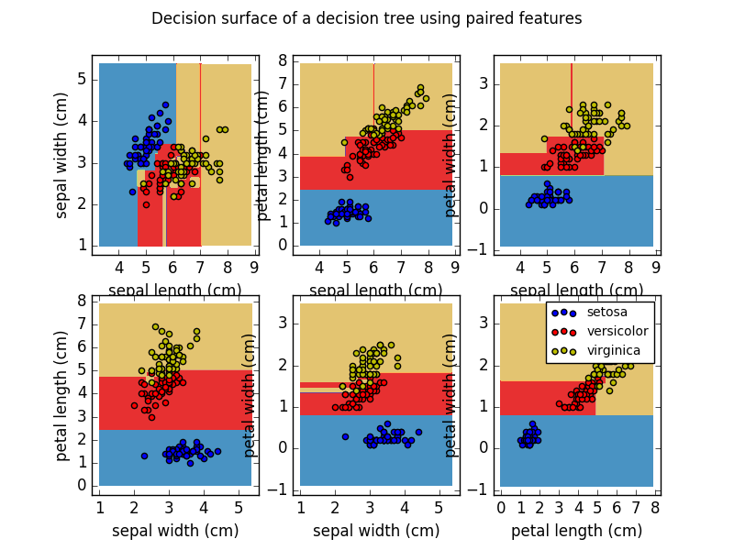
Decision Trees (Cont.)
Results of Iris Dataset Decision Tree
Source: Plot the decision surface of a decision tree on the iris dataset
Notes:
Boosting is a way or a method of combining these weak classifiers into a strong classifier…
Not going to get too in depth into the math as I’m not too familiar myself, but I believe it turns the process of choosing these classifiers into a gradient descent problem, where there is

Slide 37
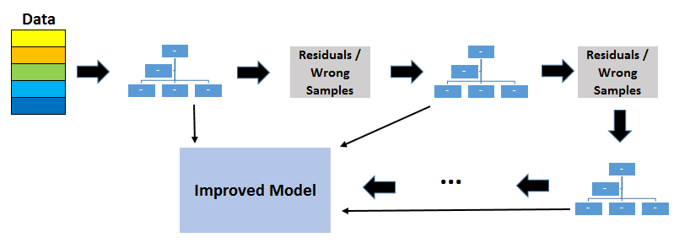
Gradient Boosting
Boosting is an iterative process where you update the weights of your weak classifiers (decision stumps) in order to make a stronger classifier.
Source: Gradient Boosted Decision Trees-Explained
Notes:
Boosting is a way or a method of combining these weak classifiers into a strong classifier…
Not going to get too in depth into the math as I’m not too familiar myself, but I believe it turns the process of choosing these classifiers into a gradient descent problem, where there is a measurable model performance or loss function that you can improve upon iteratively…

Slide 38
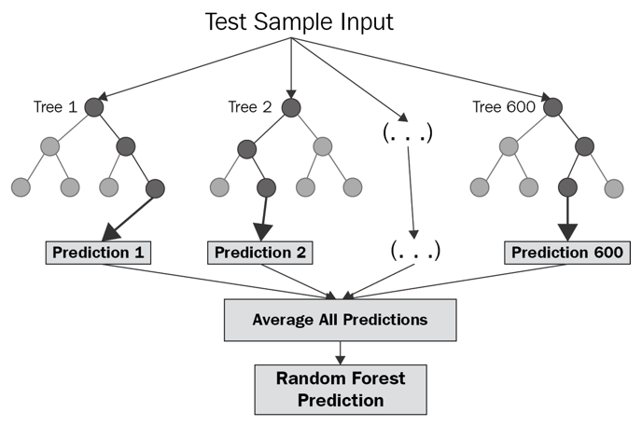

Random Forest
Random Forest is an ensemble method that averages the output of n decision trees.
Analogy: Wisdom of the crowd – with more guesses, you are more likely to be correct on average
Regression
Classification
Source: What is Random Forest?
Source: Random Forest on Wikipedia
Notes:
Random Forest utilizes a technique known as ensemble learning… This means averaging the output of multiple classifiers or models in order to obtain a more accurate answer

Slide 39
Resources
Linear Algebra -- Math 18
Vector Calculus – Math 20E
Probability and Statistics – Math 180A, Math 181A, Math 183, Math 189
Machine Learning Algorithms – CSE 151A, DSC 40A, DSC 40B
Pattern Recognition and Machine Learning by Christopher Bishop
Vectors – 3Blue1Brown
Gradient Descent
Support Vector Machine
Decision Trees
Naïve Bayes Classifier
Notes:
Pattern recognition and Machine learning – I have this book, it’s a lot of math, kinda hard to follow
Note: I skipped over naïve bayes, but it is still important to learn, check it out at this link

Slide 40
kNN Demo
Try this out on your own, we will go over it on Thursday:
https://github.com/JordanLevy99/ECE_196_Intro_to_ML/blob/master/ML%20Demos/kNN_MNIST.ipynb
Notes:
(split into 4 breakout rooms)
(give 20-30 minutes, depending on time left in class, leave 20 minutes (5:30pm return time))
(leave 10 minutes to review, another 10 minutes to go over preparing for Monday)
Before/After this, go over? selenium setup for Monday, data collection…

Slide 41
Intro to Machine Learning
ECE 196 Week 3
Thursday
Tutor: Jordan Levy

Slide 42
Recap
What Machine Learning is: Computer learns how to perform a task rather than you telling a computer how to perform a task.
Difference between Supervised and Unsupervised Learning: Labelled vs Unlabeled data, Concrete predictive task vs finding patterns in our data.
Splitting our data into Training and Testing sets
Regression versus Classification
How k-Nearest Neighbor Classifier works
Dimensionality Reduction via PCA
Basics of how Machine Learning is Implemented
Linear Model
Loss function
Learning Algorithm – Stochastic Gradient Descent
Brief Introduction to Linear Regression, Logistic Regression, Support Vector Machines

Slide 43
Learning Objectives
What is Machine Learning? (ML)
What ML is and Common Tasks
Types of Learning
Classical Machine Learning Models
Classification
k-Nearest Neighbors
Regression
Linear Regression
Steps of a Machine Learning Project
Data Collection
Data Preprocessing
Exploratory Data Analysis (EDA)
Data Cleaning
Feature Extraction/Selection
Model Selection, Performance, and Hyperparameter Tuning
Training and Testing Data
Linear Model
Loss Function
Learning Algorithm
Logistic Regression and Support Vector Machines
Dimensionality Reduction: PCA
BeautifulSoup/Selenium
Decision Trees

Slide 44



Data Collection
Traditional Data Collection
Surveys, Polling, Questionnares
Find data online
Kaggle, data.world, GitHub, etc
Web-scraping
BeautifulSoup and Selenium (Python Packages)
Crowdsourcing
MTurk, Captcha, etc.

Slide 45
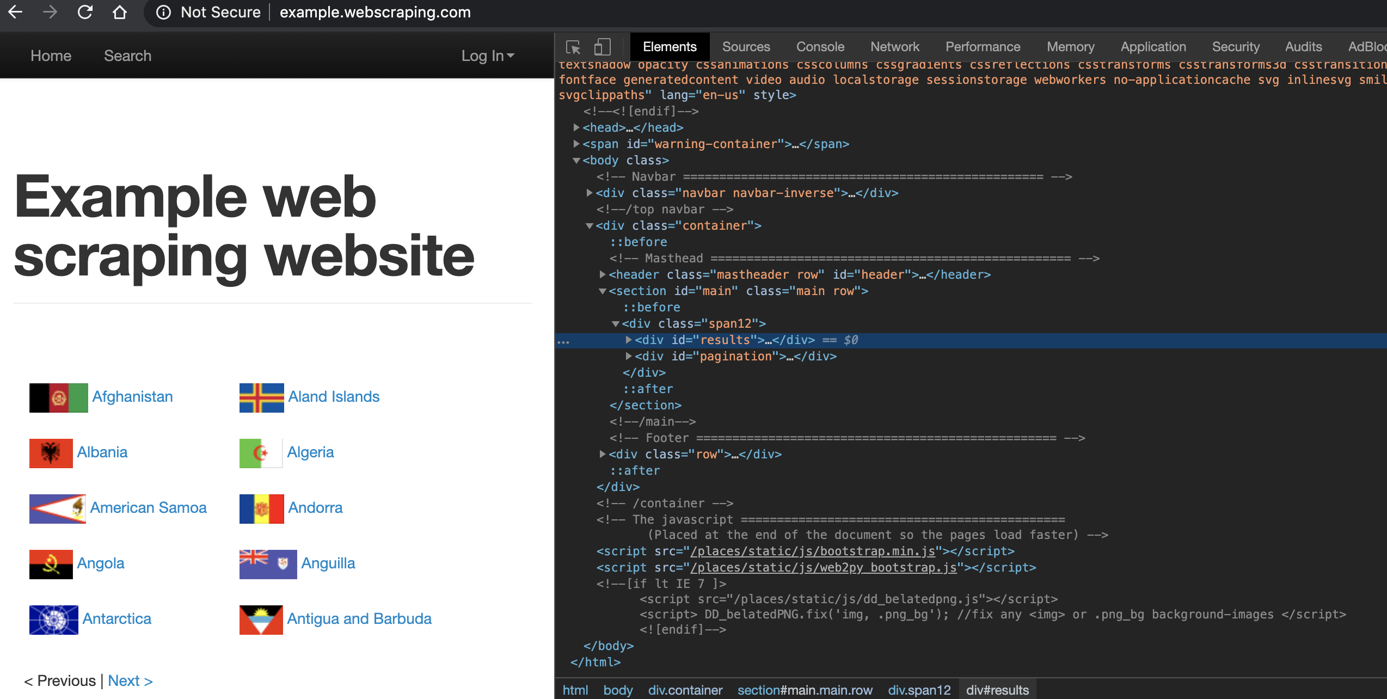
BeautifulSoup
BeautifulSoup: A web scraping package on Python that parses HTML and can programmatically find elements.
Used to scrape tables, words, any data from websites
soup = BeautifulSoup(html), where html is an html file
Common functions:
soup.find(tag, attr={})
soup.find_all(tag, attr={})
Note: Use ‘Inspect Element’ to find any webpage’s html… See example to the right.

Slide 46
Learning Objectives
What is Machine Learning? (ML)
What ML is and Common Tasks
Types of Learning
Classical Machine Learning Models
Classification
k-Nearest Neighbors
Regression
Linear Regression
Steps of a Machine Learning Project
Data Collection
Data Preprocessing
Exploratory Data Analysis (EDA)
Data Cleaning
Feature Extraction/Selection
Model Selection, Performance, and Hyperparameter Tuning
Training and Testing Data
Linear Model
Loss Function
Learning Algorithm
Logistic Regression and Support Vector Machines
Dimensionality Reduction: PCA
BeautifulSoup/Selenium
Decision Trees

Slide 47
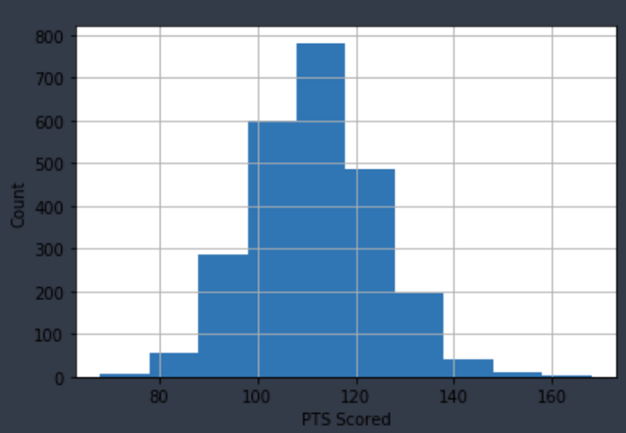
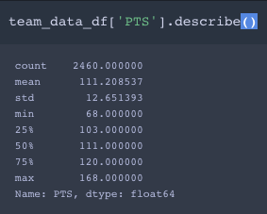
Exploratory Data Analysis (EDA)
Exploratory Data Analysis: Get to know your dataset.
EDA includes anything from graphs and charts to summary statistics and more.
Univariate and Bivariate Analysis: This includes making histograms for univariate, scatter plots for bivariate, and running Linear Regression between a feature column and target column.
Notes:
Once you have a dataset, you will want to learn more about your data.
This step can be closely connected to the next two steps, Data Cleaning and Feature Extraction.

Slide 48
Data Cleaning
Data is oftentimes messy, contains non-standard formats, has null values, etc.
Data Cleaning involves dropping columns that aren’t necessary, imputing missing values, checking for outliers, etc...
Anything to prepare a dataset for a Machine Learning model
Goes hand in hand with Feature Extraction and Engineering
Missing Values
Missing by Design – surveys, questionnaires, etc.
MCAR – Missing Completely at Random
MAR – Missing at Random
NMAR – Not Missing at Random
Imputing Missing Values: Can drop, impute with 0, impute by mean, median, or some other probability distribution.

Slide 49
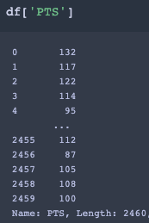
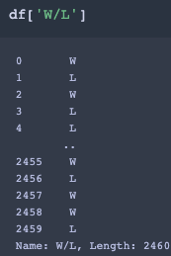
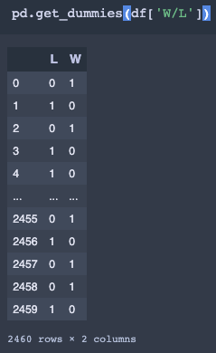
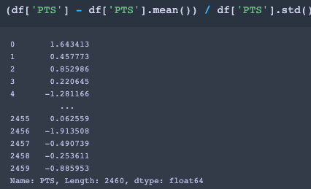
Feature Extraction and Engineering
Find which Features will best help us make our prediction
Derived Features that are combinations of other features can be useful
Univariate Analysis and Bivariate Analysis: Determine which features will be useful
Standardization: Remove bias in different scales of variables, convert to a standard scale
One-Hot Encoding: Represent a categorical variable as a vector of 0’s and 1’s
Standardization Example
One-Hot Encoding Example
vs.
vs.

Slide 50
Learning Objectives
What is Machine Learning? (ML)
What ML is and Common Tasks
Types of Learning
Classical Machine Learning Models
Classification
k-Nearest Neighbors
Regression
Linear Regression
Steps of a Machine Learning Project
Data Collection
Data Preprocessing
Exploratory Data Analysis (EDA)
Data Cleaning
Feature Extraction/Selection
Model Selection, Performance, and Hyperparameter Tuning
Training and Testing Data
Linear Model
Loss Function
Learning Algorithm
Logistic Regression and Support Vector Machines
Dimensionality Reduction: PCA
BeautifulSoup/Selenium
Decision Trees

Slide 51

Model Selection
Pick the model that works best for your problem.
So far, we have gone over:
Regression:
Linear Regression
Random Forest
Classification:
K-Nearest Neighbors
Logistic Regression
Support Vector Machines
Random Forest
Refer to sklearn documentation for more models.
Common sklearn functions in each Model:
model.fit(X_train, y_train) -- Generates the weights and biases for your model given your training data.
model.predict(X_test) – Generates predictions for y given an input matrix X.
model.score(X_test, y_test) – Produces accuracy metric for model on a given X and y.

Slide 52
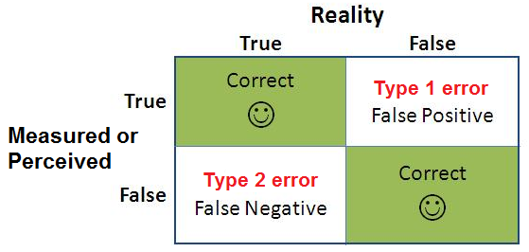
Model Performance
Once we select a model, we want to test its performance.
Classification Accuracy Metrics
Percent Correct
Type I error rate
Type II error rate
Balanced Error Rate: ½ (Type I errors+ Type II errors)
Regression Accuracy Metrics
R2_score: Measure of how linearly correlated your prediction is to your actual output.
Mean Squared Error (MSE): On average, the square of how far your predictions varied from the actual output.
Example: MSE of 9 – average deviation of 3 from the actual output.

Slide 53
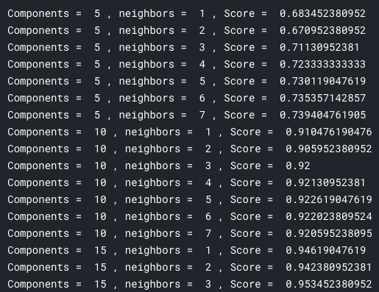
Hyperparameter Tuning
Hyperparameter: A variable set by the user that adjusts some aspect of the Machine Learning Model.
Use a for loop to loop through different hyperparameters and see which one gives the best performance.
Examples:
k in K-Nearest Neighbor
n_components in PCA
Loss function
Hyperparameter Tuning on KNN with PCA (MNIST)
Source: https://www.kaggle.com/gregnetols/mnist-with-pca-and-knn

Slide 54
Demo – NBA Win Classification
https://github.com/JordanLevy99/ECE_196_Intro_to_ML

Slide 55
Conclusion
Machine Learning is Data Centric
Computers are good at Computing, more high-quality data usually results in higher accuracy
Garbage In - Garbage Out
Algorithms are important, but data is more important, your model can only be as good as your data.
Overfitting
A big issue in Machine Learning, making your model too complex to where it does
not generalize to unseen data
Data Ethics
Check robots.txt of any website to see their data-scraping policies
Be careful with any personal data
Source: https://en.wikipedia.org/wiki/Overfitting

